Slide 1



CANE SHOOTING GAME
REVIEW-3
BY:
NISHA P (23CDR112)
PRANEETHA R S (23CDR123)
26.04.2025

Slide 2
Project Description
There is a lack of:
Simple 2D games suitable for beginners
Engaging gameplay that keeps users interested
Customizable projects that help students experiment and learn
Cane Shooting addresses this gap by:
Offering an arcade-style 2D shooting game
Using Python and Pygame for easy and fun game development
Including SQLite to store and display high scores

Slide 3
GOAL
To develop a simple, fun, and educational 2D shooting game using Python and Pygame that helps learners understand the basics of game development and database integration.
OBJECTIVE
Develop a playable 2D arcade shooting game using Python and Pygame.
Enable player interaction through keyboard controls for movement and shooting.
Implement collision detection to reward players for hitting targets.
Create a scoring system that tracks and displays points in real-time.
Use SQLite to store high scores, so they persist between game sessions.
3

Slide 4
Types of Module
Player control module - Handles Player movement using arrow keys.
Enemy module - Handles movement patterns and interaction with players.
Weapon system module – Manages the weapons.
Collision detection module – Detect and handle collisions between game objects.
Scoring module – Manages the game score.
Game over and restart module – Manages the game over state and restart options.

Slide 5
Technologies Used
Python – A beginner-friendly programming language used to build the game logic.
Pygame – A library in Python for creating 2D games with graphics, sound, and user input.
SQLite – A lightweight database used to store and retrieve high scores locally.
Software Used
Visual studio code.
5

Slide 6
System Architecture
Frontend: Handles user input, rendering, animation
Backend: Controls game logic, physics, and scoring
Database: Stores and retrieves high scores persistently
Code module
game.py - Controls main game loop, rendering, and gameplay
data.py - Handles database operations: save, fetch, reset scores
highscore.db - Stores high score entries locally

Slide 7
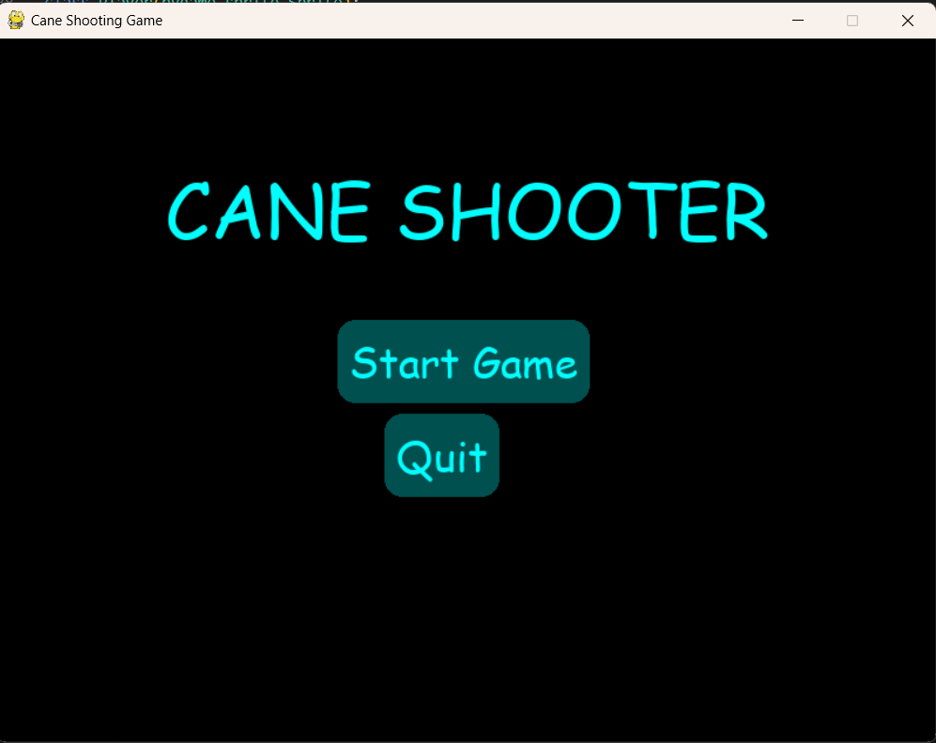
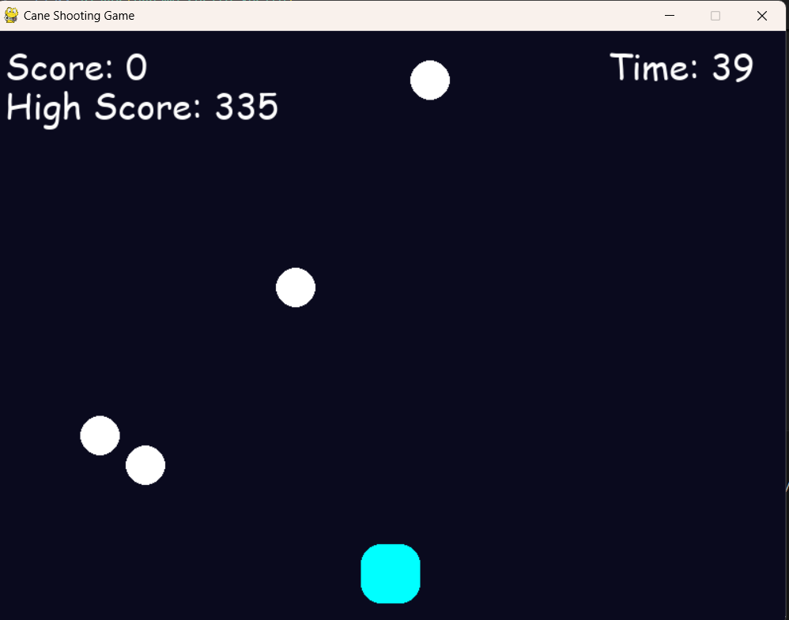
IMPLEMENTATION

Slide 8
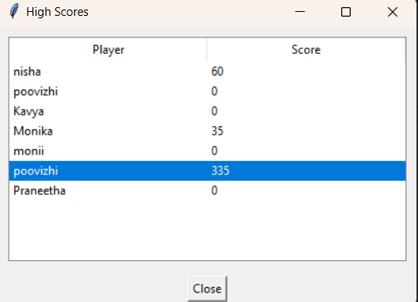
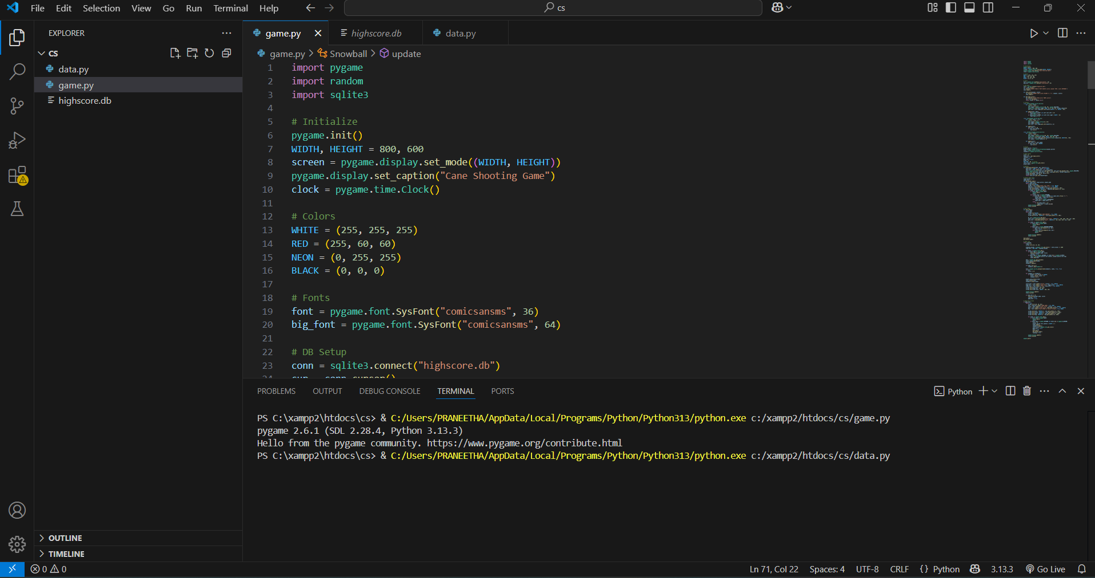

Slide 9
Thank you!!

